Slide 1
Heats of Reaction and Calorimetry
Heat of reaction, q_{rxn.}
  The quantity of heat exchanged between a system and its surroundings when a chemical reaction occurs within the system, at constant temperature.
Prentice-Hall © 2002
General Chemistry: Chapter 7
Slide <number> of 50
Notes:
Chemistry 140 Fall 2002
In practice, the temperature is allowed to change and the heat that is lost or needed as the system returns to its original temperature is calculated.

Slide 2
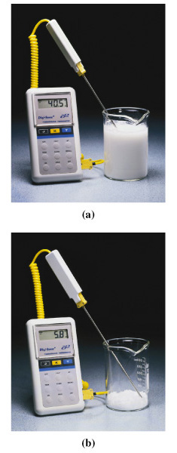
Heats of Reaction
Exothermic reactions.
  Produces heat
  For exothermic reaction, heat of reaction is a negative quantity (q_{rxn} < 0).
Endothermic reactions.
  Consumes heat from surroundings
  For endothermic reaction, heat of reaction is a positive quantity (q_{rxn} > 0).
Prentice-Hall © 2002
General Chemistry: Chapter 7
Slide <number> of 50
Notes:
Chemistry 140 Fall 2002
Heat of reaction in an isolated system produces a change in the thermal energy of the system. The causes a temperature change.
In an non-isolated system the temperature remains constant and the heat is transferred to the surroundings.
Top picture is CaO(s) + H₂O(l) → Ca(OH)₂
Bottome picture is Ba(OH)₂·8H₂O + 2NH₄Cl(s)→BaCl₂(s) + 2 NH₃(aq) + 8 H₂O(l)

Slide 3
Calorimeter
Calorimeter: A device for measuring quantities of heat transferred during a reaction.
Two types of calorimeters will be discussed in isolated systems
1. Bomb Calorimeter
2. Coffee-Cup Calorimeter
1. Bomb Calorimeter
Bomb calorimeter is used to measure the heat released during a
combustion reaction, or burning of a flammable substance
Combustion reaction is any reaction that produces a flame and heat
Prentice-Hall © 2002
General Chemistry: Chapter 7
Slide <number> of 50

Slide 4
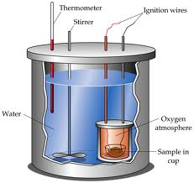
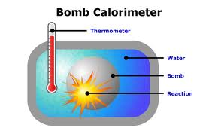
Bomb Calorimeter
Bomb calorimeter is for measuring the heat evolved at constant volume (ΔE)
Heat of reaction is the quantity of heat
the system would have to lose to its
surroundings to be restored to its initial temperature
q_{rxn} = -q_{cal}
q_{cal} = q_{bomb} + q_{water} + q_{wires} +…
ht
Define the heat capacity of the calorimeter:
q_{cal} = m_{i}c_{i}ΔT = CΔT
Prentice-Hall © 2002
General Chemistry: Chapter 7
Slide <number> of 50
Notes:
Chemistry 140 Fall 2002
System includes everything inside the double walled container. All the water, wires, stirrer, thermometer, and the reaction chamber.
Bomb is filled with sample and assembled. Then pressurized witih O₂. A short pulse of electric current heats the sample and ignites it. The final temperature of the calorimeter assembly is determined after the combustion reaction.
Because the reaction is carried out at a fixed volume we say that this is at constant volume.

Slide 5
Example
Using Bomb Calorimetry Data to Determine a Heat of Reaction.
The combustion of 1.010 g sucrose, C₁₂H₂₂O₁₁ in a bomb calorimeter, causes the temperature to rise from 24.92 to 28.33°C. The heat capacity of the calorimeter assembly is 4.90 kJ/°C.
What is the heat of combustion of sucrose, expressed in kJ per mol C₁₂H₂₂O₁₁
Prentice-Hall © 2002
General Chemistry: Chapter 7
Slide <number> of 50

Slide 6
Example
Example 7-3
Calculate q_{calorimeter}:
q_{cal} = CΔT = (4.90 kJ/°C)(28.33-24.92)°C = (4.90)(3.41) kJ
= 16.7 kJ
Calculate q_{rxn}:
q_{rxn} = -q_{cal} = -16.7 kJ
per 1.010 g
Prentice-Hall © 2002
General Chemistry: Chapter 7
Slide <number> of 50

Slide 7
Example
Example 7-3
Calculate q_{rxn} in the required units:
So, heat of combustion of per gram of sucrose is:
-16.7 kJ
q_{rxn} = -q_{cal} =
= -16.5 kJ/g
1.010 g
Heat of combustion of per mole of sucrose:
342.3 g
q_{rxn}
= -16.5 kJ/g
1.00 mol
= -5.65 x 10³ kJ/mol
Prentice-Hall © 2002
General Chemistry: Chapter 7
Slide <number> of 50

Slide 8
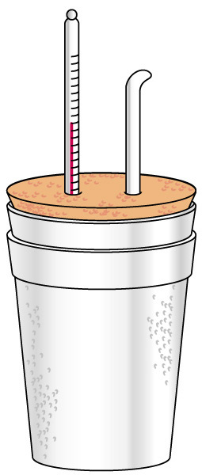
Coffee Cup Calorimeter
A simple calorimeter.
  Well insulated and therefore isolated.
  Measure temperature change.
q_{rxn} = -q_{cal}
Prentice-Hall © 2002
General Chemistry: Chapter 7
Slide <number> of 50

Slide 9
First Law of Thermodynamics
First law of thermodynamics is based on the law of conservation of energy
First law of thermodynamics states that energy can
be converted from one form to another, but can not
be created or destroyed
In other words, the total internal energy of an
isolated system is constant
Prentice-Hall © 2002
General Chemistry: Chapter 7
Slide <number> of 50

Slide 10
First Law of Thermodynamics
A system contains only internal energy.
  A system does not contain heat or work.
  These only occur during a change in the system.
Law of Conservation of Energy
  The energy of an isolated system is constant
ΔU = q + w
Prentice-Hall © 2002
General Chemistry: Chapter 7
Slide <number> of 50

